Slide 1
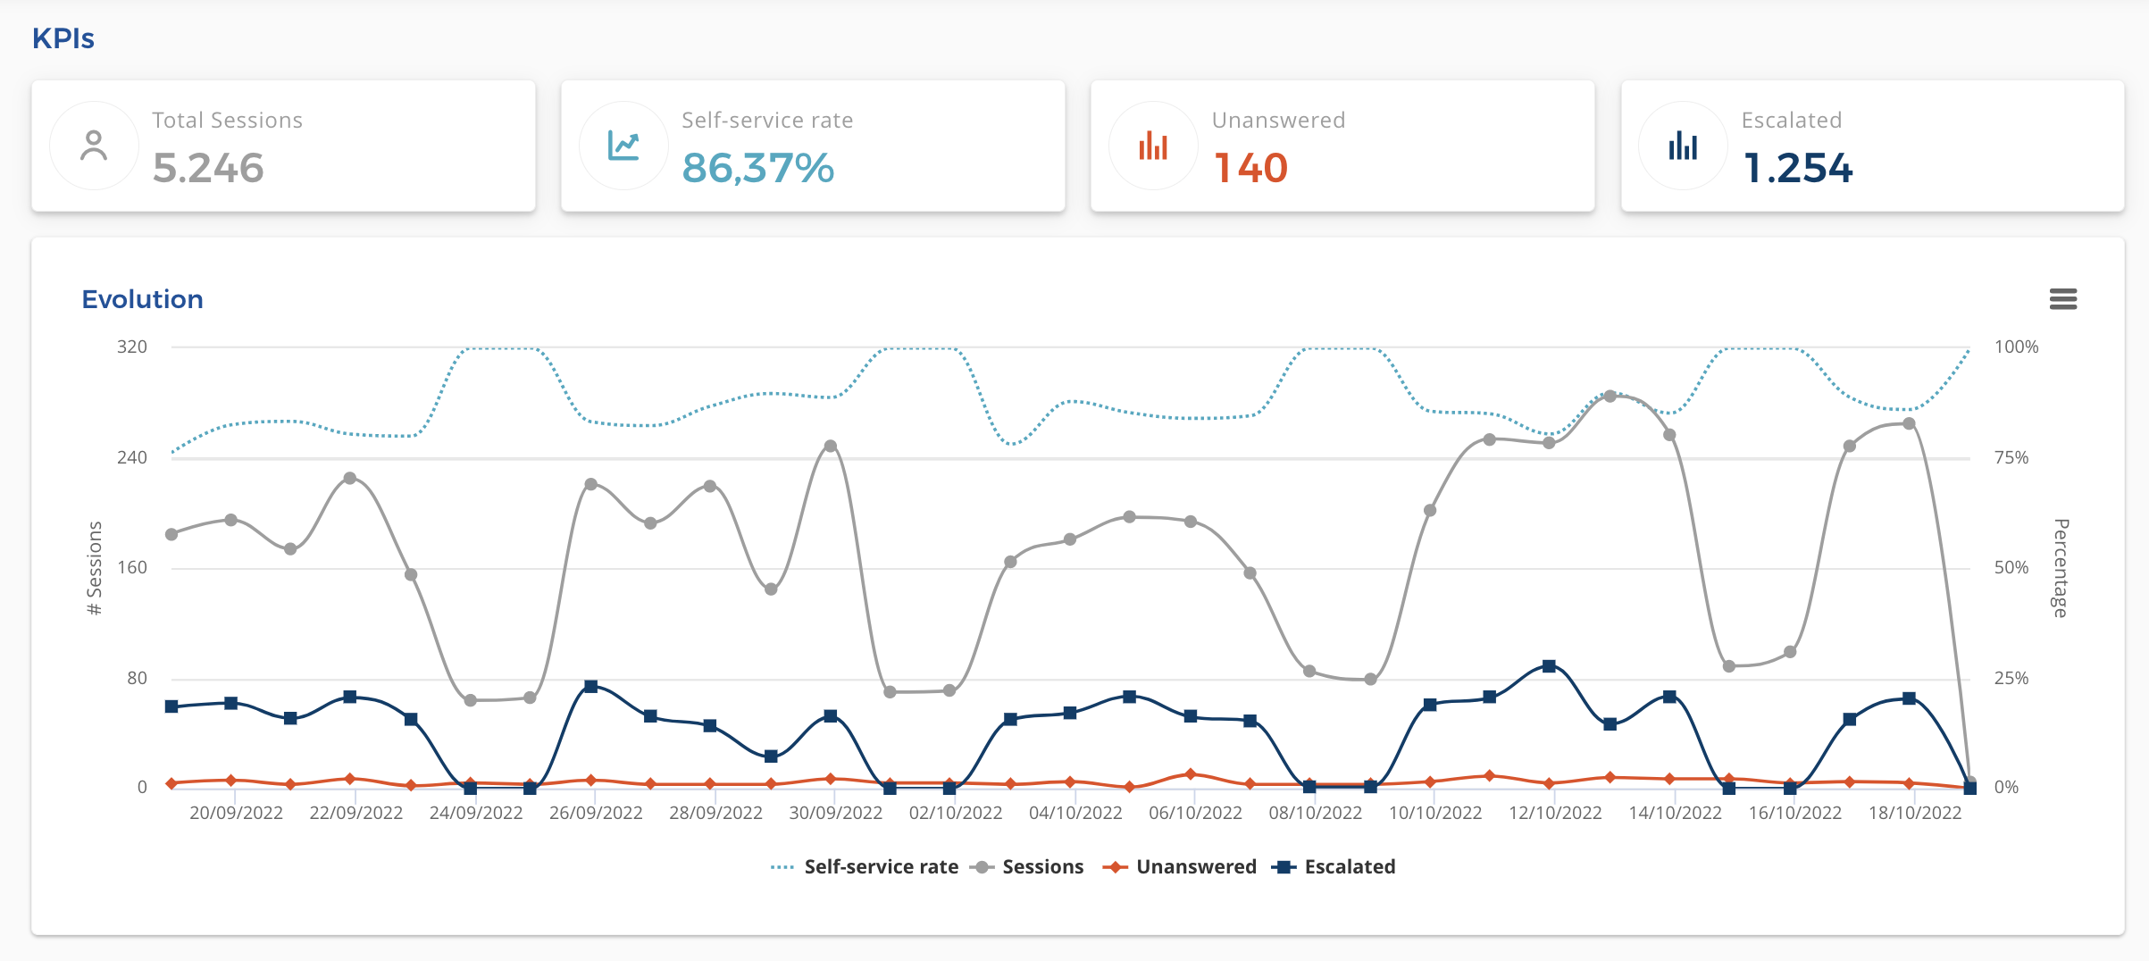
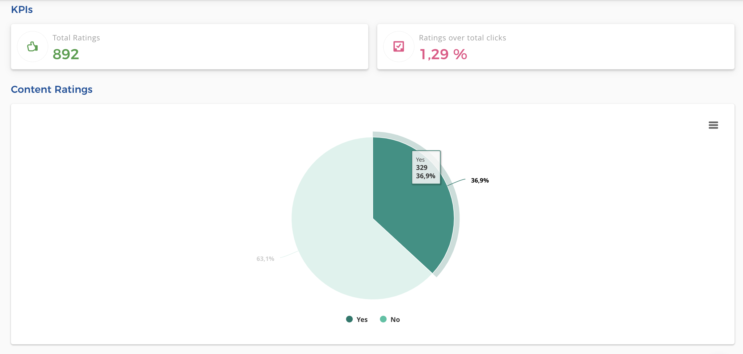
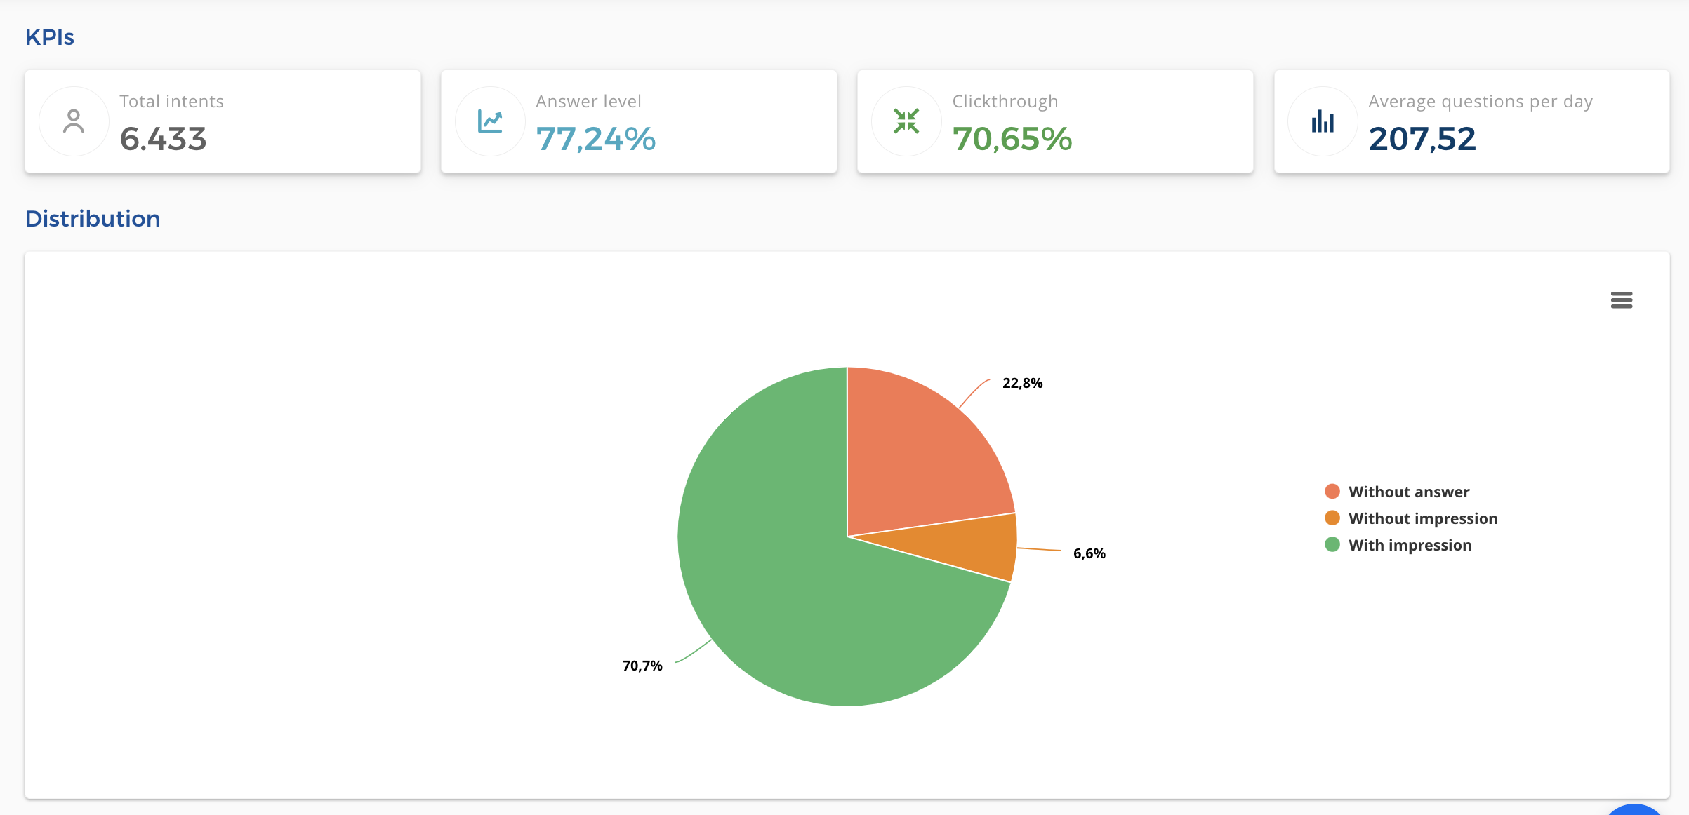
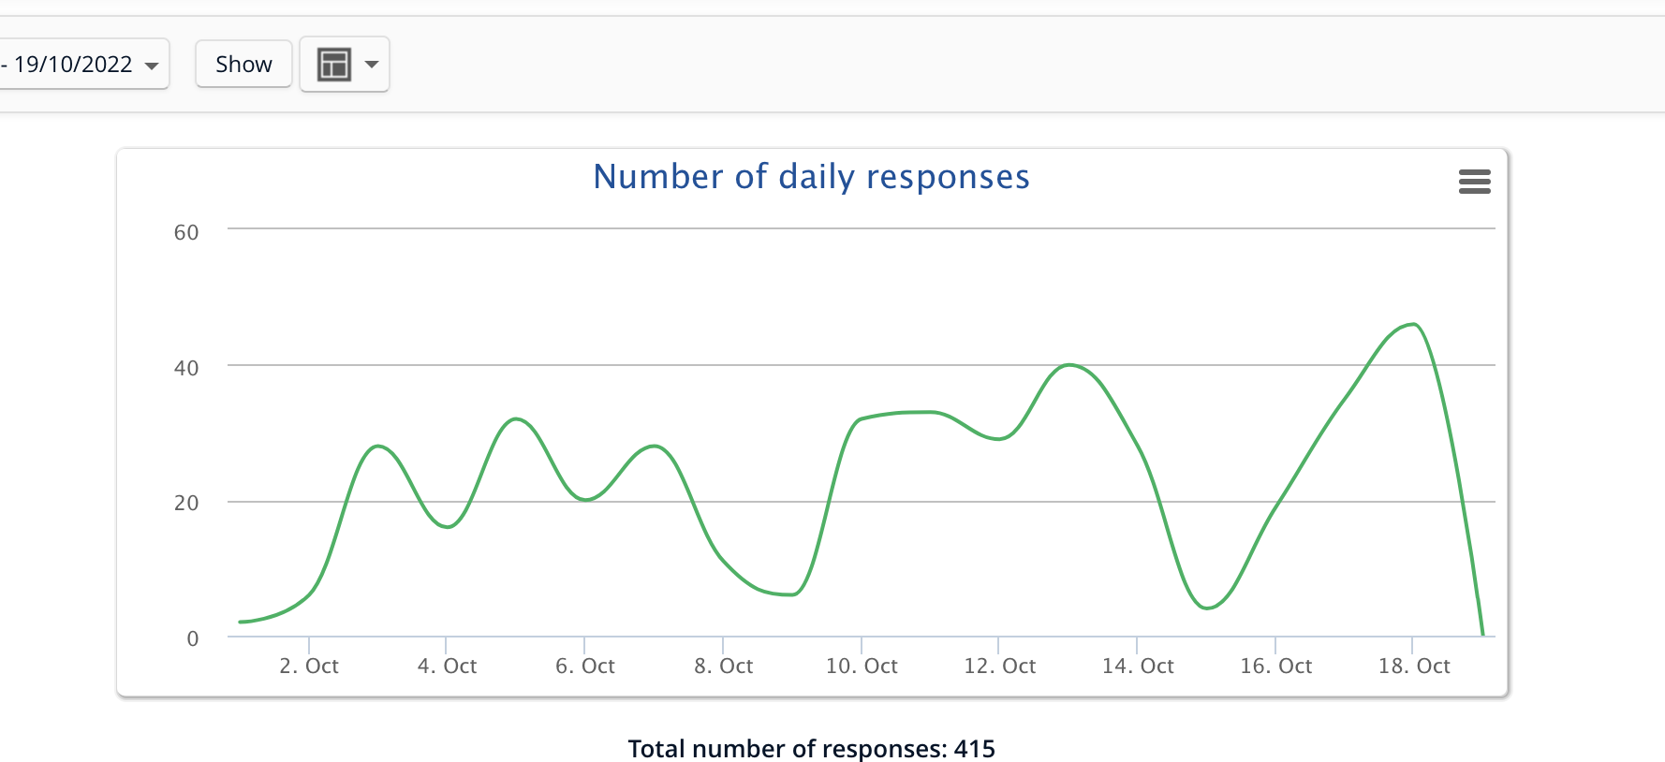
Dashboard Analytics
Track performance in real time
Volume of interactions
Evolution
Self-Service
Answer rate
Escalations
User satisfaction
Content performance
Category performance
User questions
…

